Slide 1

A Microclimate Case-Study Comparison of Arizona Soundings
David G. Lopez
Advised By:
Dr. R.S. Cerveny
School of Geographical Sciences and Urban Planning
Arizona State University
Arizona Space Grant Consortium 2023 Symposium
Sponsored by: Dr. Bo Svoma

Slide 2
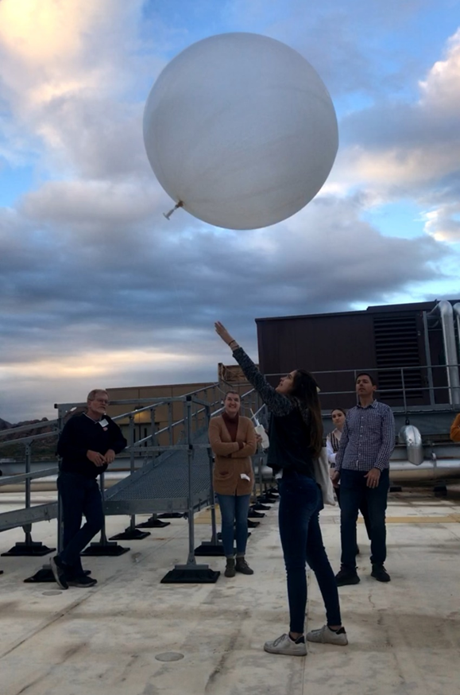
Research Question and Hypothesis
Radiosondes are launched aboard weather balloons twice daily around the world (0000 UTC and 1200 UTC). Radiosonde observations are used to create upper-air maps, and are used as initial conditions in weather models. In Arizona, the Flagstaff and Tucson National Weather Service (NWS) offices are upper-air stations.
Is a Phoenix radiosonde launched at 0000 UTC in the late autumn warranted to aid in weather forecasting?
This project seeks to understand the applicability of launching radiosondes from the Phoenix NWS during the late autumn season to aid in weather forecasting. Methods:
Through a case study, we have launched a 0000 UTC (11/10/2022) radiosonde from the Phoenix NWS office to compare with the Tucson NWS’s sounding.

Slide 3
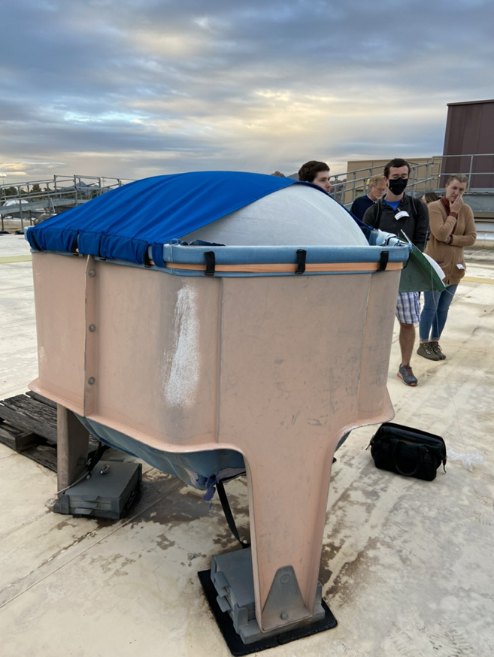
Educational Outcomes
Simultaneously used as a teaching experience for the ASU Meteorological Instruments and Measurements course (GPH 413/513)
Students:
Visited the Phoenix NWS office and met with Phoenix NWS forecasters
Learned about radiosondes and weather balloons from Salt River Project (SRP) meteorologist, Dr. Bo Svoma

Slide 4
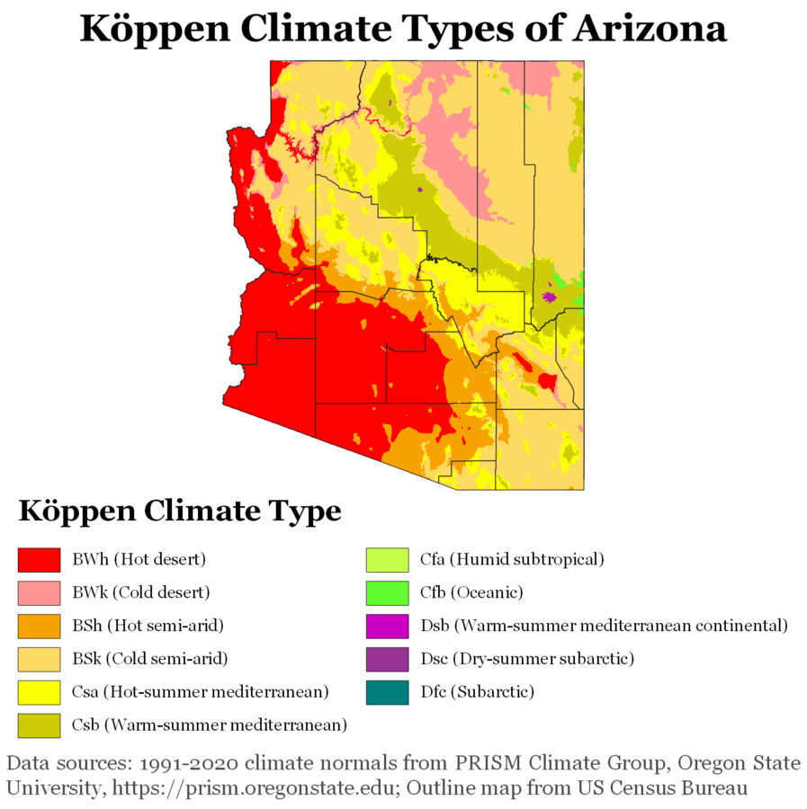
Urban
Microclimate
Fine climatic structure of the air space that extends from the very surface of the earth to a height where the effects of the immediate character of the underlying surface no longer can be distinguished from the general local climate
Affected by pavement, buildings, air pollution, dense inhabitation, etc.
Geiger, R. 1951. Compendium of Meteorology. 993–1003. https://glossary.ametsoc.org/wiki/Microclimate

Slide 5
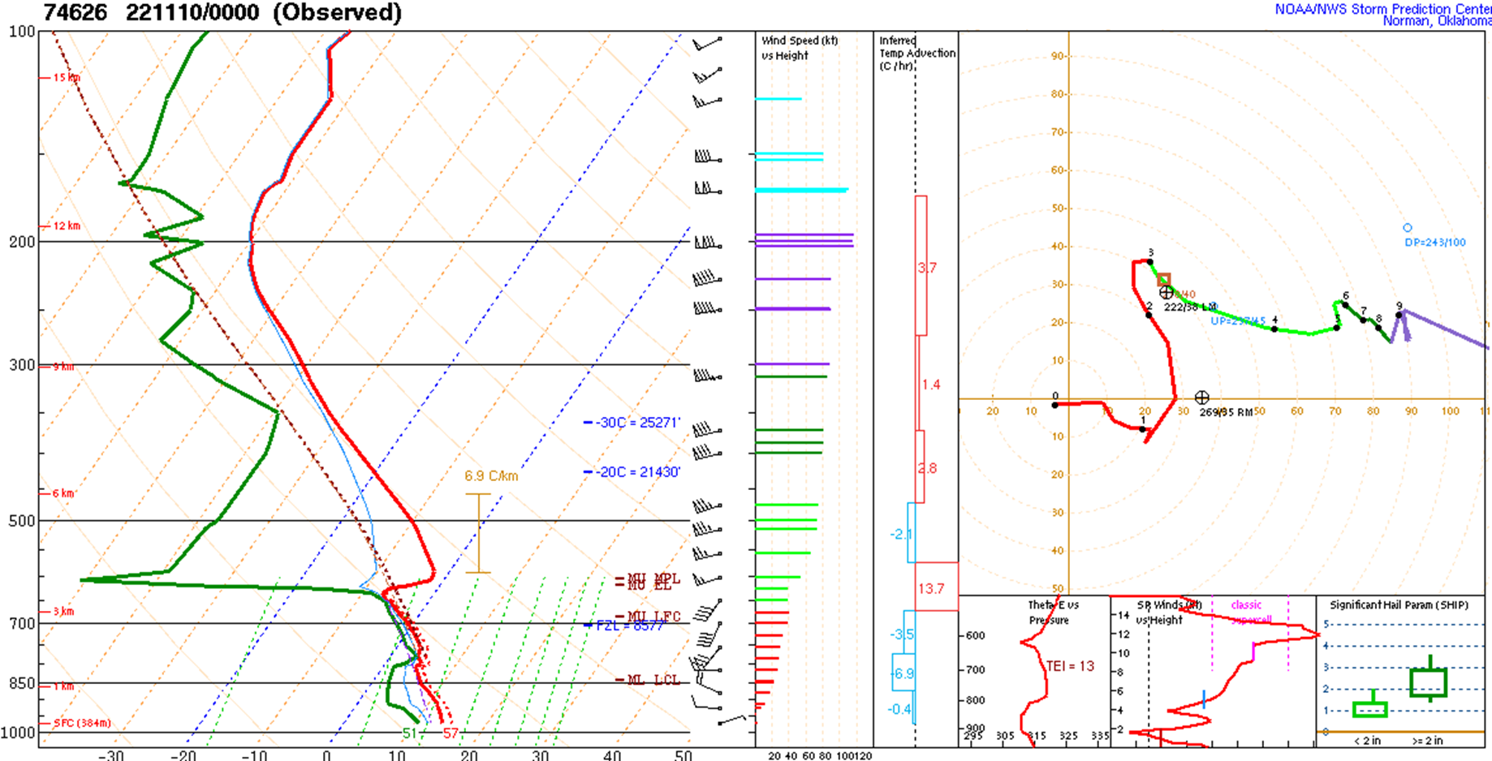
Figure 1.1. Sounding analysis for the 0000 UTC (11/10/2022) Phoenix National Weather Service radiosonde. Accessed from https://www.spc.noaa.gov/exper/soundings/ on 11/10/2022.

Slide 6
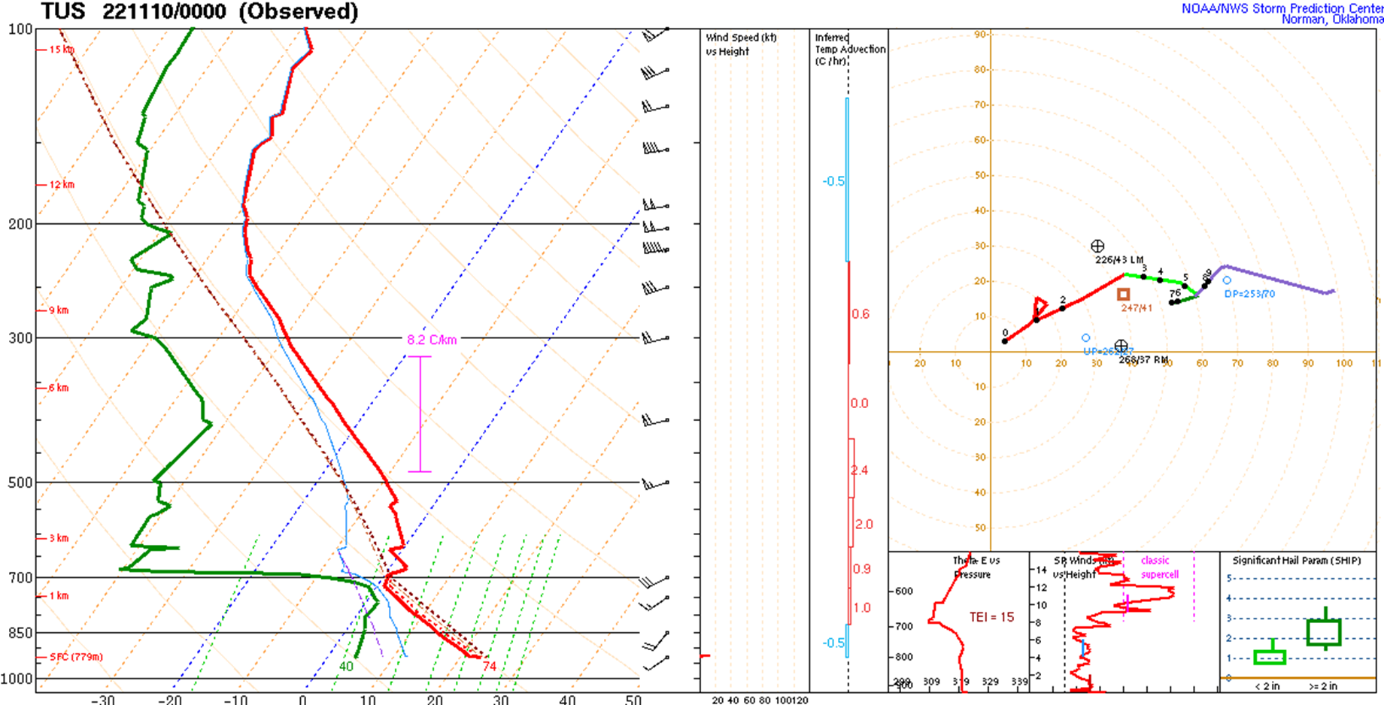
Figure 1.2. Sounding analysis for the 0000 UTC (11/10/2022) Tucson National Weather Service radiosonde. Accessed from https://www.spc.noaa.gov/exper/soundings/ on 11/10/2022.

Slide 7
Results and Discussion
Significant differences in sounding analysis that affected weather forecasting occurred primarily within the planetary boundary layer
Phoenix sounding analysis showed a convective available potential energy (CAPE) of 24 J/kg
Phoenix sounding analysis captured saturation, precipitation, and evaporation of precipitation, verified with radar
A Phoenix radiosonde launched at 0000 UTC in the late autumn can aid weather forecasting, though may not always be warranted.

Slide 8
Acknowledgments
A special thanks to Dr. Bo Svoma for sponsoring this project. Dr. Svoma, SRP meteorologist, supplied the radiosonde, weather balloon, and helium, as well as organized the Phoenix NWS visit for the ASU Meteorological Instruments and Measurements course (GPH 413/513).

